Slide 1
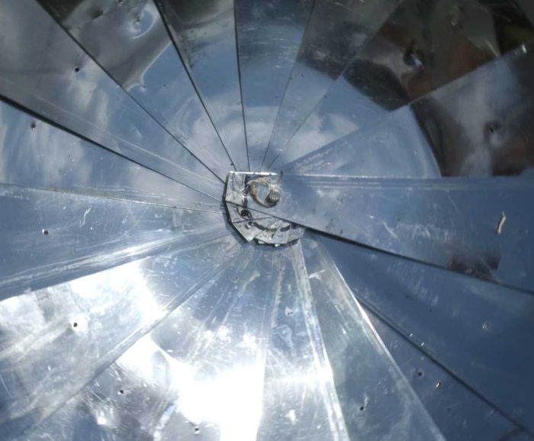
Parabolic Solar Cookers
Lonny Grafman
Most Images from Appropedia
Outline
Background
Basics
Design Examples
More Examples
Math and Physics Resources
Discussion

Slide 2
1000 watts/m²
Notes:
Power of the sun
Sun image http://upload.wikimedia.org/wikipedia/commons/d/da/171879main_LimbFlareJan12_lg.jpg
aka
317 Btu/(hr*ft²)

Slide 3
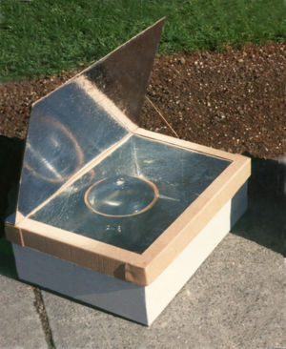
Solar Box Cooker
aka Solar Oven
Notes:
Sun image http://upload.wikimedia.org/wikipedia/commons/d/da/171879main_LimbFlareJan12_lg.jpg
http://www.appropedia.org/Image:Solarbox.jpg

Slide 4
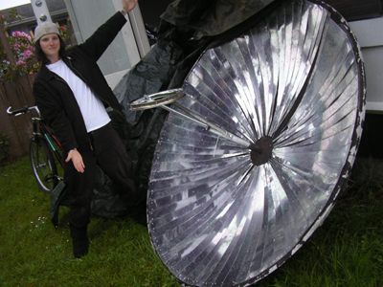
Solar Parabolic Cooker
Notes:
Sun image http://upload.wikimedia.org/wikipedia/commons/d/da/171879main_LimbFlareJan12_lg.jpg
http://www.appropedia.org/Image:Solarbox.jpg

Slide 5
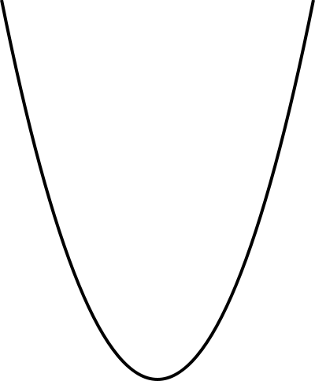
The Parabola
Notes:
Sun image http://upload.wikimedia.org/wikipedia/commons/d/da/171879main_LimbFlareJan12_lg.jpg
http://www.appropedia.org/Image:Solarbox.jpg

Slide 6
y=ax²
f=1/(4a)
y
f
x
Notes:
Sun image http://upload.wikimedia.org/wikipedia/commons/d/da/171879main_LimbFlareJan12_lg.jpg
http://www.appropedia.org/Image:Solarbox.jpg

Slide 7
The Parabola - Definition
http://www.cut-the-knot.org/ctk/Parabola.shtml#Theorem1

Slide 8
The Parabola - Reflection
http://www.cut-the-knot.org/ctk/Parabola.shtml#Theorem1

Slide 9
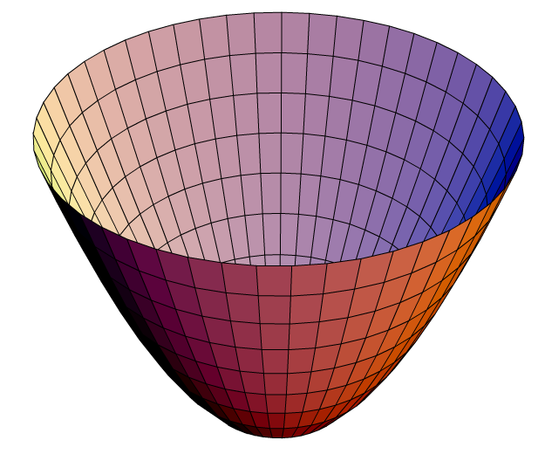
The Paraboloid
The Parabola
Notes:
Sun image http://upload.wikimedia.org/wikipedia/commons/d/da/171879main_LimbFlareJan12_lg.jpg
http://www.appropedia.org/Image:Solarbox.jpg

Slide 10
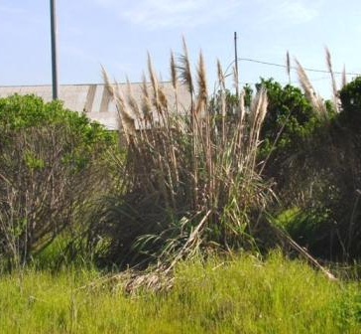
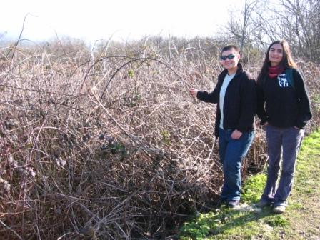
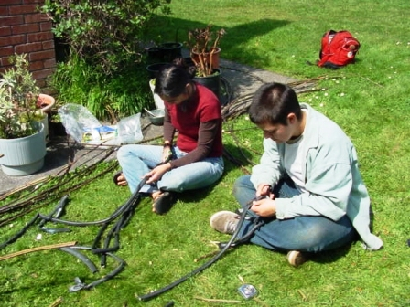
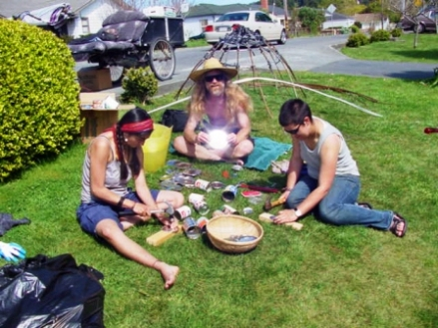
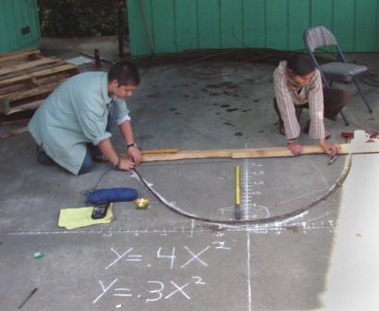
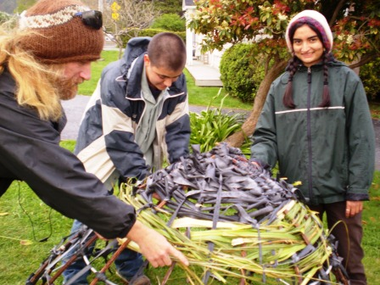
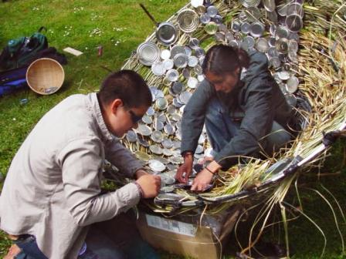
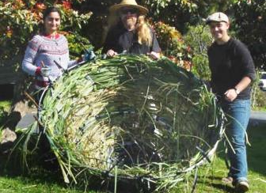
Design Objective:
To create a solar cooker from local invasive species and waste materials that can pasteurize water and be a cooking alternative to the use of fossil fuels.
Design Criteria:
Use of local materials
Efficiency
Durability
Ease of use
Ease of construction
Cost
Impact on environment
Impact on lifestyle
Notes:
Parabolic basket and tin can solar cooker

Slide 11
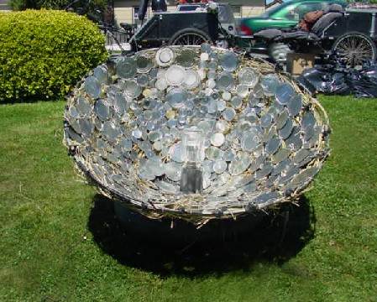
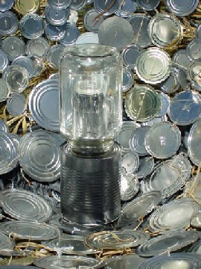
Results:
Equation: y =.5x²
Time to boil quart: ~2 hrs
Deformation Lessons Learned:
more blackberry runners
more rigid material for rings
Reflectivity Lessons Learned:
pampas grass too lumpy
no dull, small can lids

Slide 12
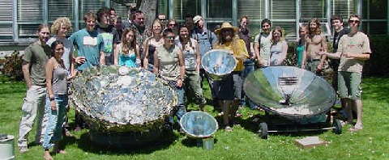
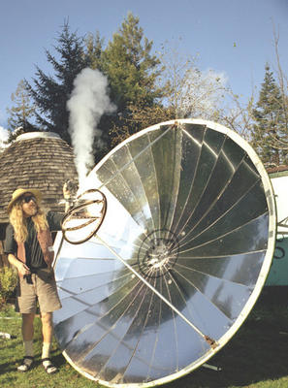
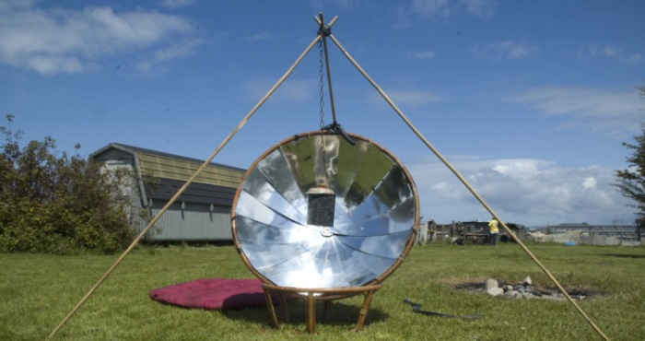
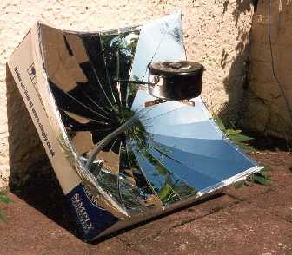
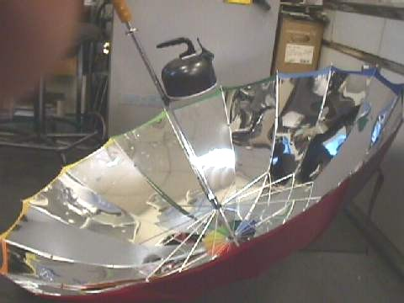
Notes:
Parabolic basket and tin can solar cooker

Slide 13
Protection from Dazzles and Burns
Appropriate focal point size
Glasses and gloves
Deep dish focus
Physical barrier
Physical separation
Appropriate system size

Slide 14
Define the Problem
Test and Implement the Solution
Analyze and Select a Solution
Generate Alternative Solutions
Gather Information
Engineering Design Process

